Slide 1
Human Capital Data Manipulation and Modeling
Objective: Show how raw HR/training data was transformed into a structured data model (facts + dimensions).
Tech stack: Azure Data Factory (ETL orchestration) + PySpark (transformations).

Slide 2
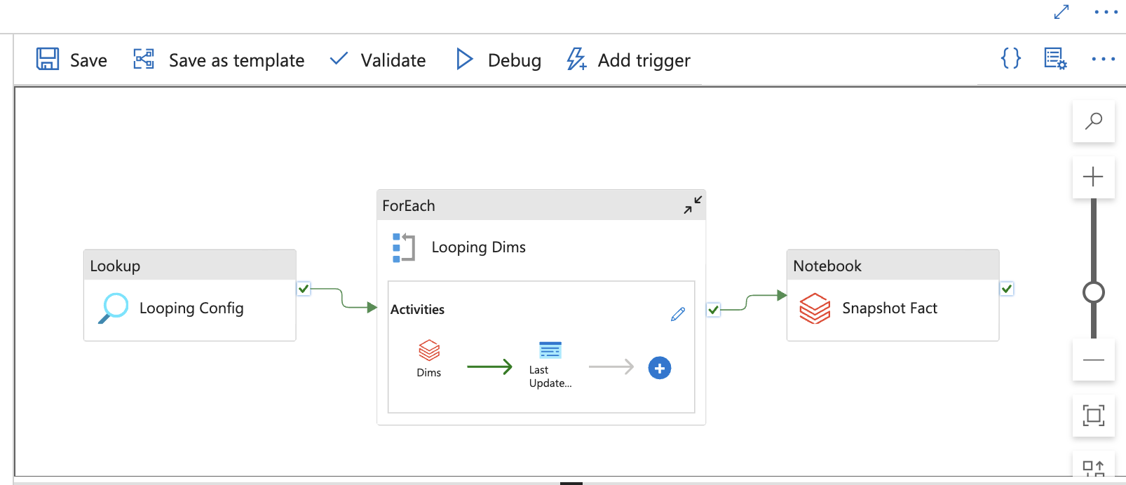
Pipeline Orchestation
As a orchestration tool, Azure Data Factory are used, it has been looping multiple data source ingestion and manipulation steps with config table at the beginning and running separate notebooks as part of transformations

Slide 3
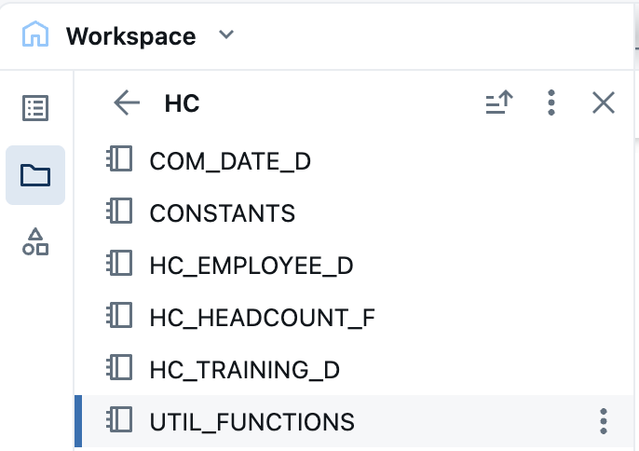
Databricks Notebooks Structure
There are total 6 notebooks, Constants include all the constant value, Util Functions include common python and UDF functions in it.
There are total three dimensions, which are Date, Employee and Training dimensions.
There is only one snapshot fact table to show monthly headcount details with training informations

Slide 4
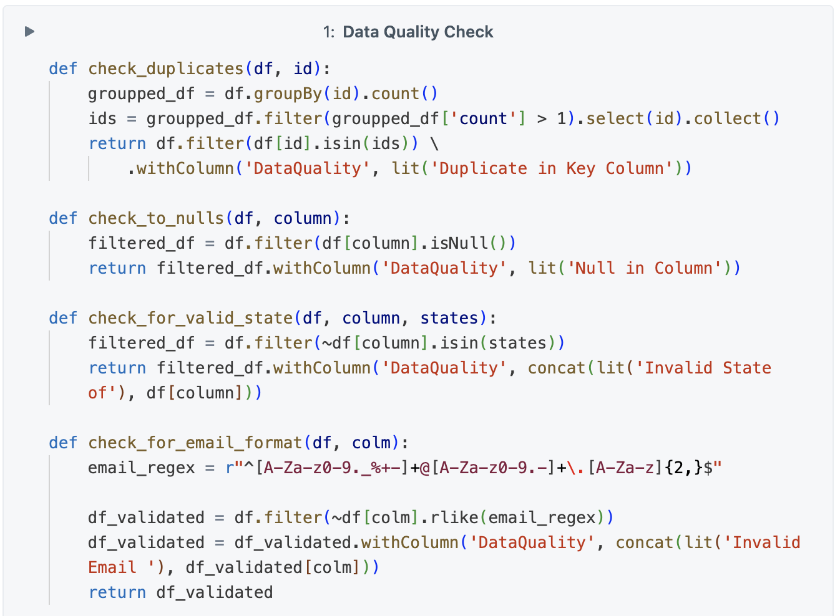
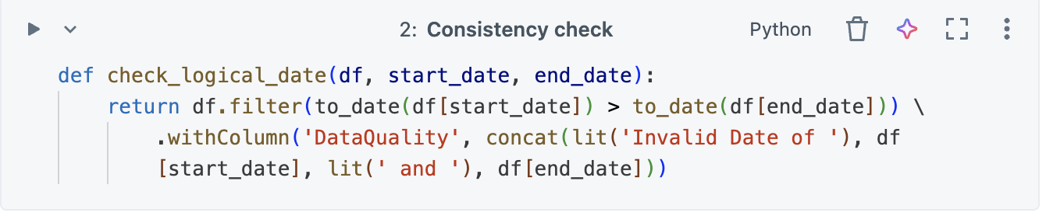
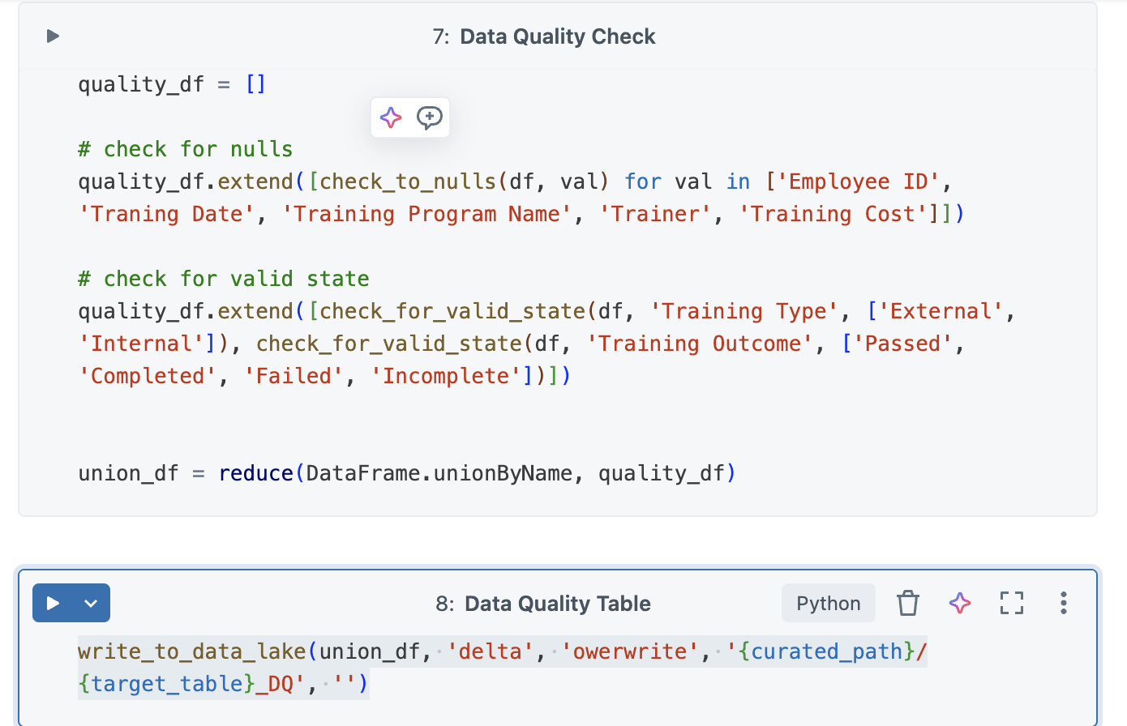
Data Quality and Consistency Check
There are multiple functions writted to check data quality and consistency, and they are checked as part of notebook and if there are data quality issue data was writted to other delta file with reason

Slide 5
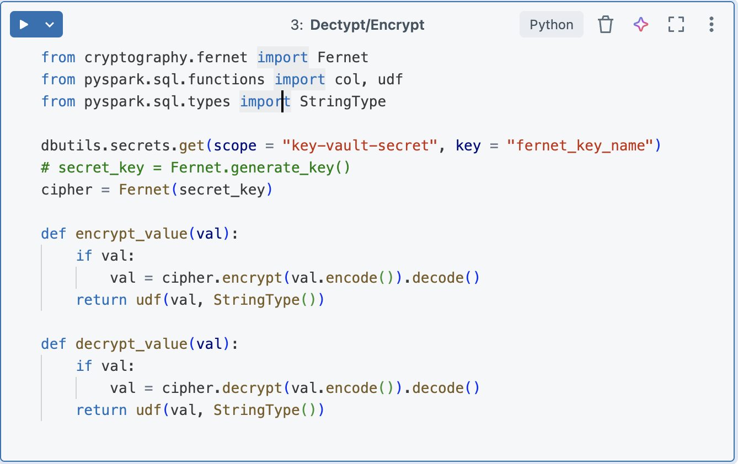
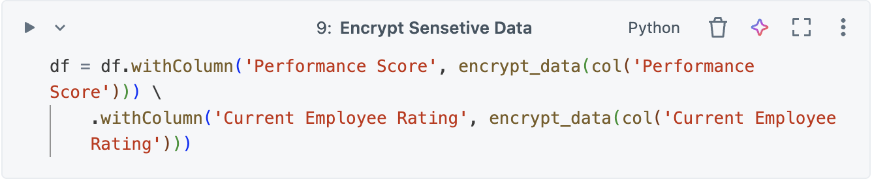
Data Security
Decription Key stored in key valut secrets instead of storing it files which will be published to git
Decryption functions are used to PII columns like performance related informations, thouse columns are encrypted before saving delta lake

Slide 6
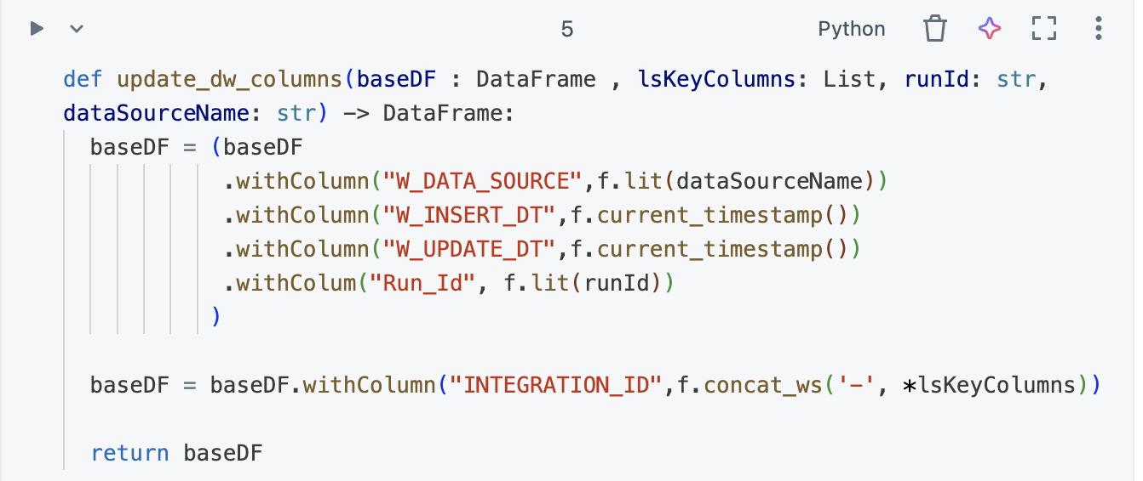
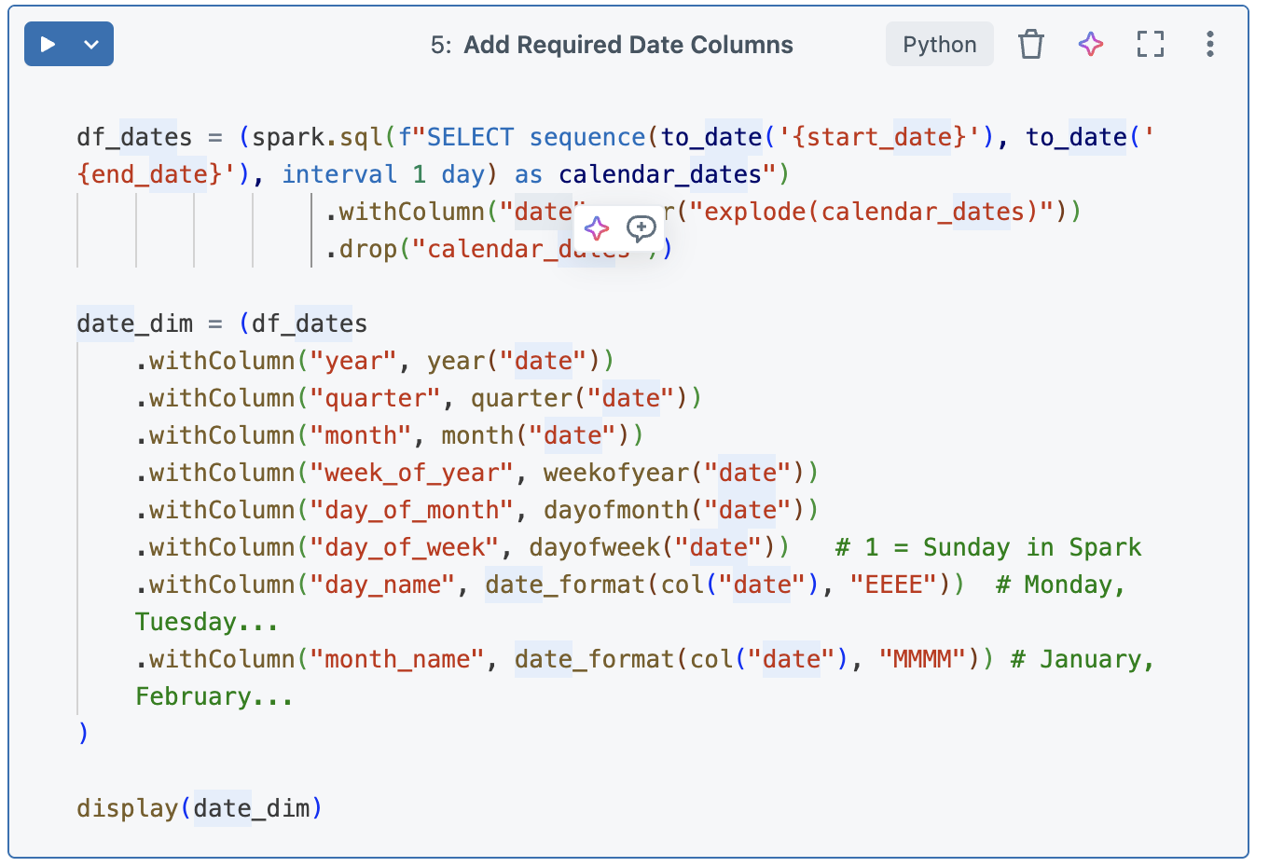
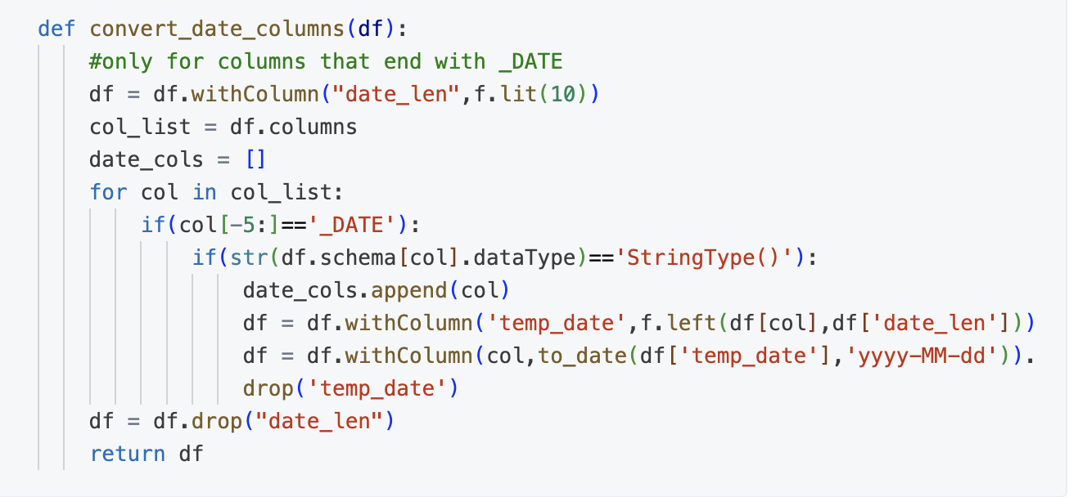
Data Transformations
There are functions to add logging columns, casting dates and generating date dimension

Slide 7
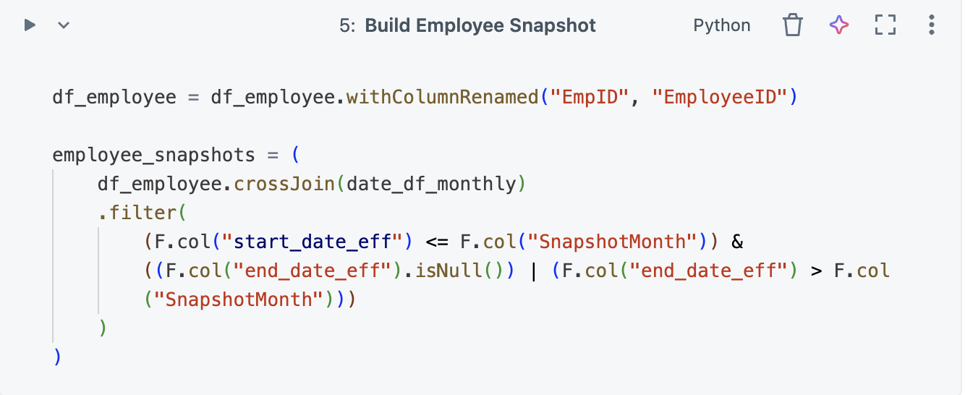
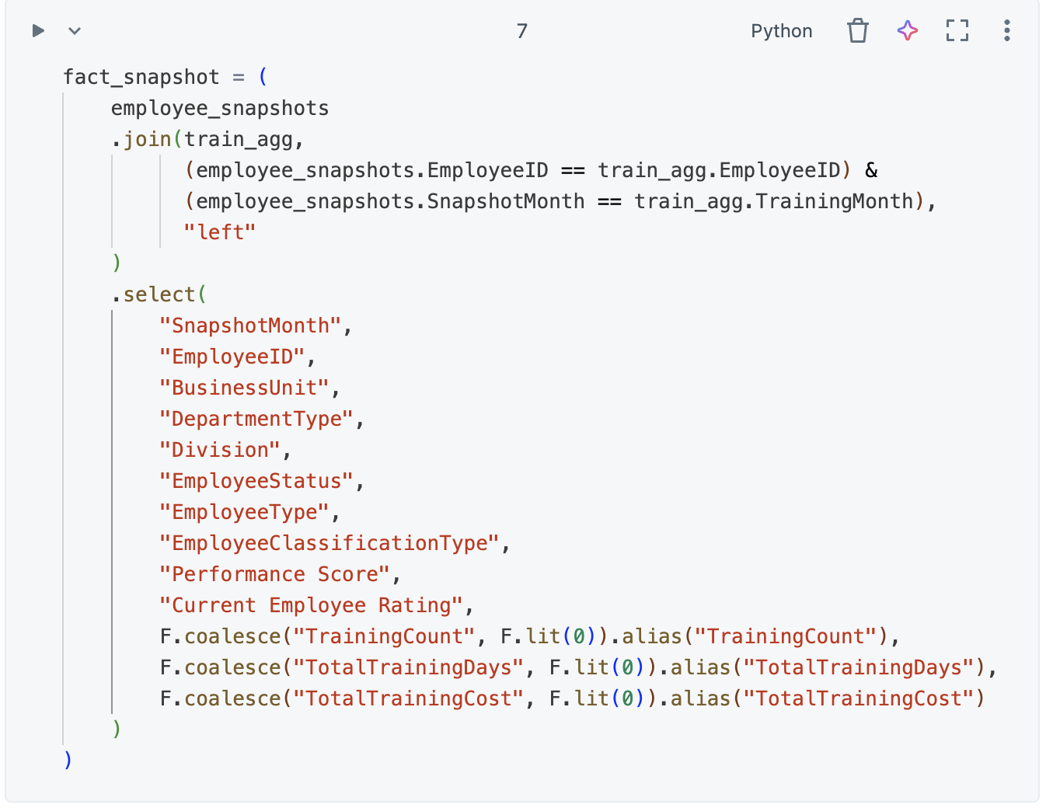
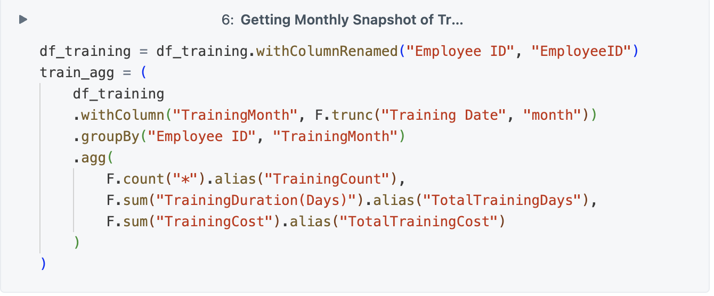
Head Count Logic
Date and Employee dims and Traning are joined and finally only changable fields are selected in fact

Slide 8
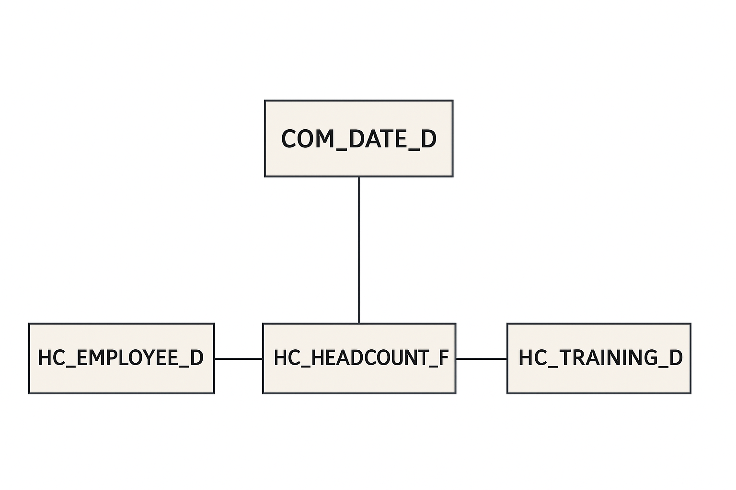
Data Model Diagram

Slide 9
Link for Resources
Link for Github Repo: https://github.com/MurodjonErgashov/assignment
Thank you for your attention.

